Slide 1
Data type in C#
Jidesh Govinda Baidya
Developer

Slide 2
On basic of memory allocation data type can be classified into
Value type(store in stack)
Reference type(store in heap but store the reference in the stack)

Slide 3
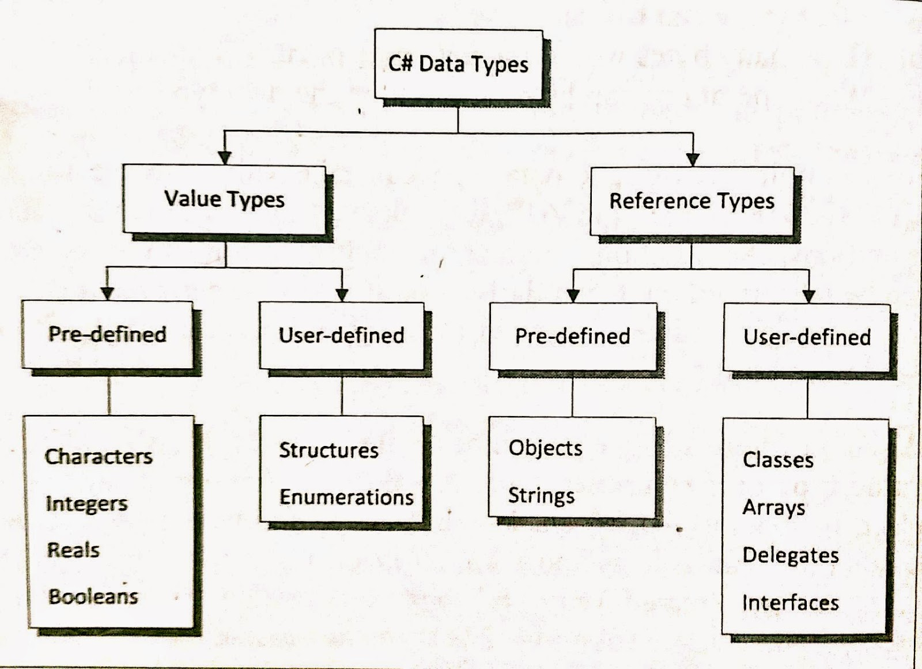

Slide 4
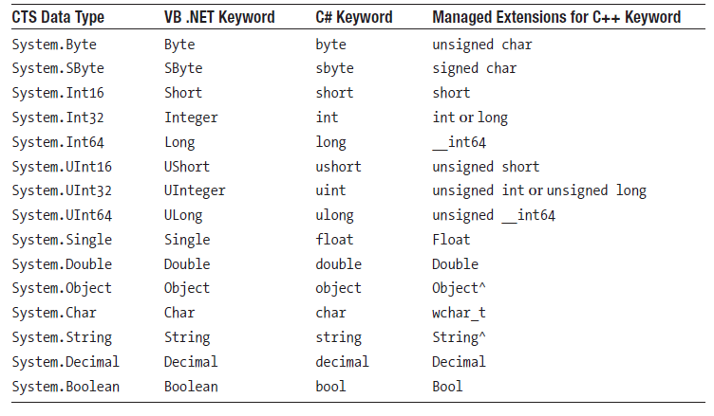

Slide 5
Value types
Store the value in stack
Can be classified in
Struct
enum

Slide 6
Reference type
Stores the vale in heap and its reference in stack
Can be classified in
String
Arrays
Object
Class
interface
Delegate

Slide 7
Data type intro
The C# language comes with a set of Basic data types.
These data types are used to build values which are used within an application.
Let's explore the basic data types available in C#.

Slide 8
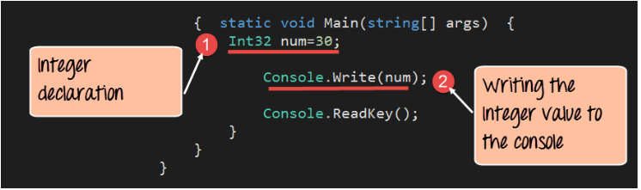
Integer
Integer are used to work with numbers
In C#, the datatype is denoted by the Int32 keyword.
Below is an example of how this datatype can be used.
In our example, we will define an Int32 variable called num.
We will then assign an Integer value to the variable and then display it accordingly.

Slide 9
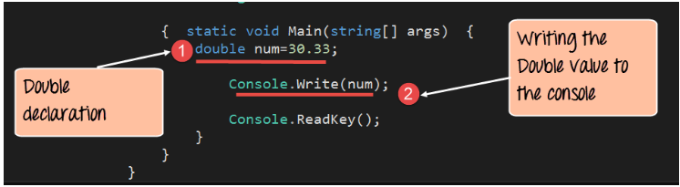
Double
A double data type is used to work with decimals.
In C#, the datatype is denoted by the keyword "Double". Below is an example of this datatype.
In our example, we will define a double variable called num.
We will then assign a Double value to the variable and then display it accordingly.

Slide 10
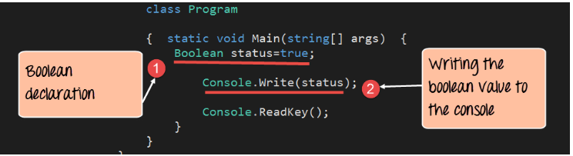
Boolean
A boolean data type is used to work with Boolean values of true and false.
In C#, the datatype is denoted by the Boolean keyword. Below is an example of this datatype can be used.
our example, we will define a Boolean variable called 'status.‘
We will then assign a boolean value to the variable and then display it accordingly.

Slide 11
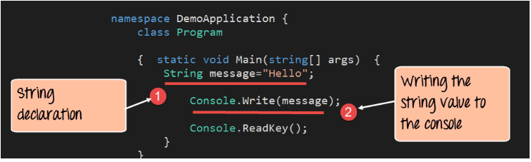
string
A String data type is used to work with String values.
In C#, the datatype is denoted by the keyword 'String'. Below is an example of this datatype.
In our example, we will define a String variable called 'message.'
We will then assign a String value to the variable and then display it accordingly.

Slide 12
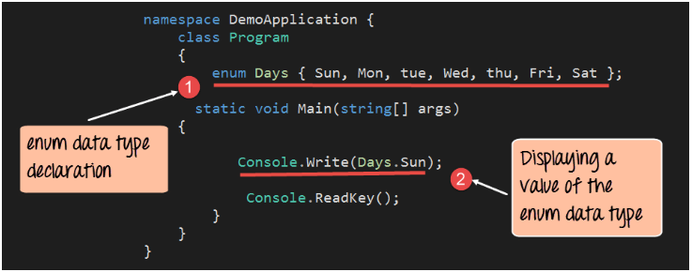
C# Enumeration
An enumeration is used in any programming language to define a constant set of values.
In C#, the enumeration is defined with the help of the keyword 'enum'.
In our example, we will define an enumeration called days, which will be used to store the days of the week.

Slide 13
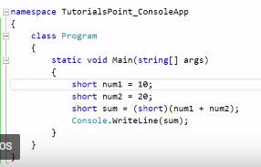
Typecasting converting one data type to another

Slide 14
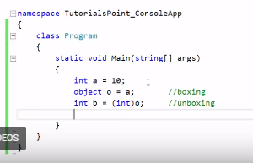
Boxing ad unboxing

Slide 15
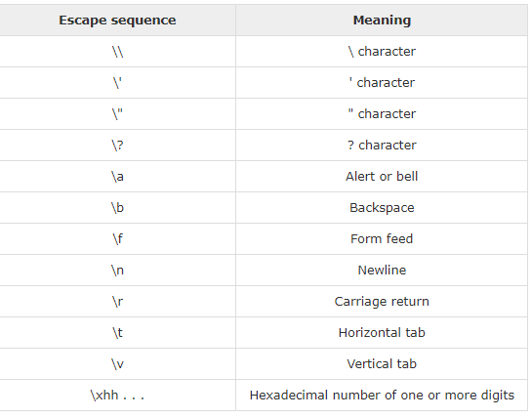
Character constant
Character literals are enclosed in single quotes.

